Slide 1
WEEK-6 JOURNEY PPT
Name: - Arka Kumar Saha
Employee ID: - 654830
Alias Id: - INAUFS
Batch-1

Slide 2
Day-1
No classes due to Ganesh Chaturthi.
Practiced on VM.

Slide 3
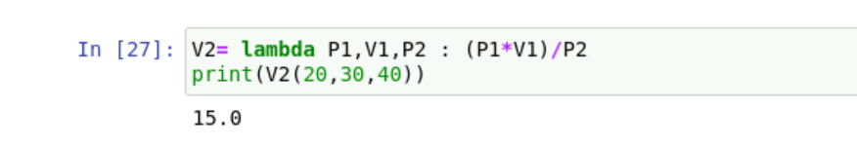
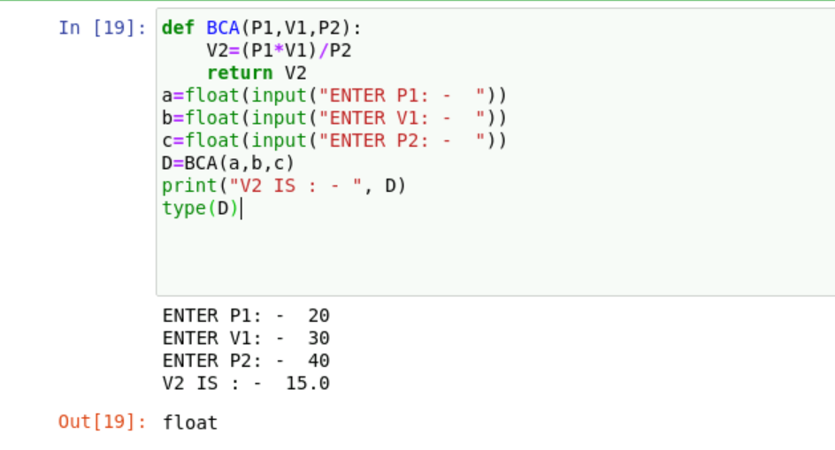
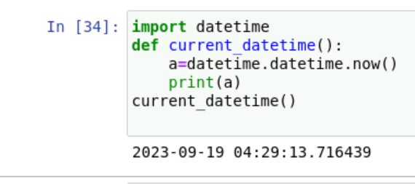
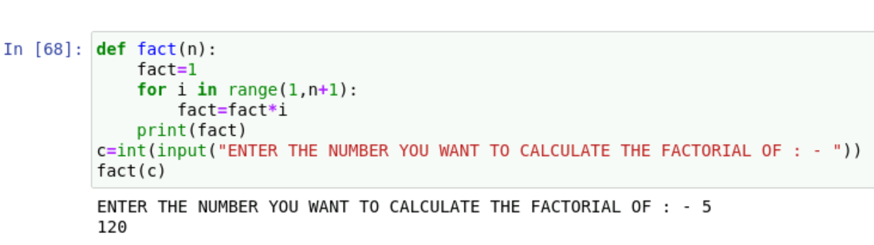
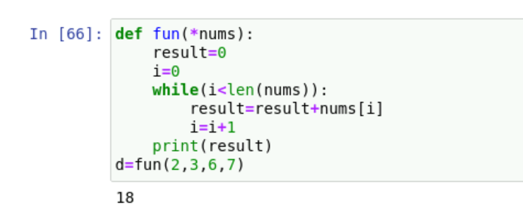
Day-2(19th Sept)
Hands on of python

Slide 4
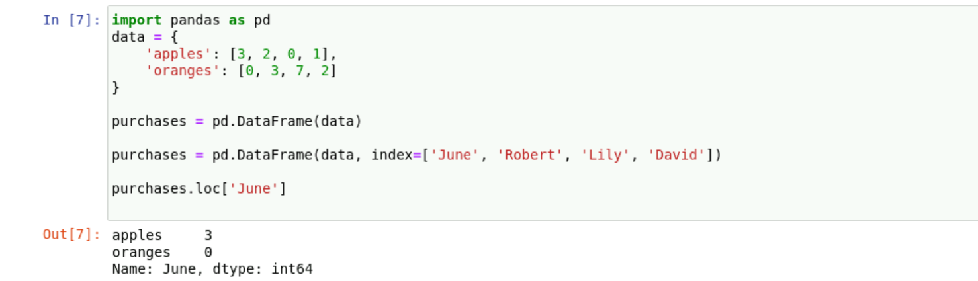
Day-3Wednesday(20th Sept)
Hands on of python

Slide 5
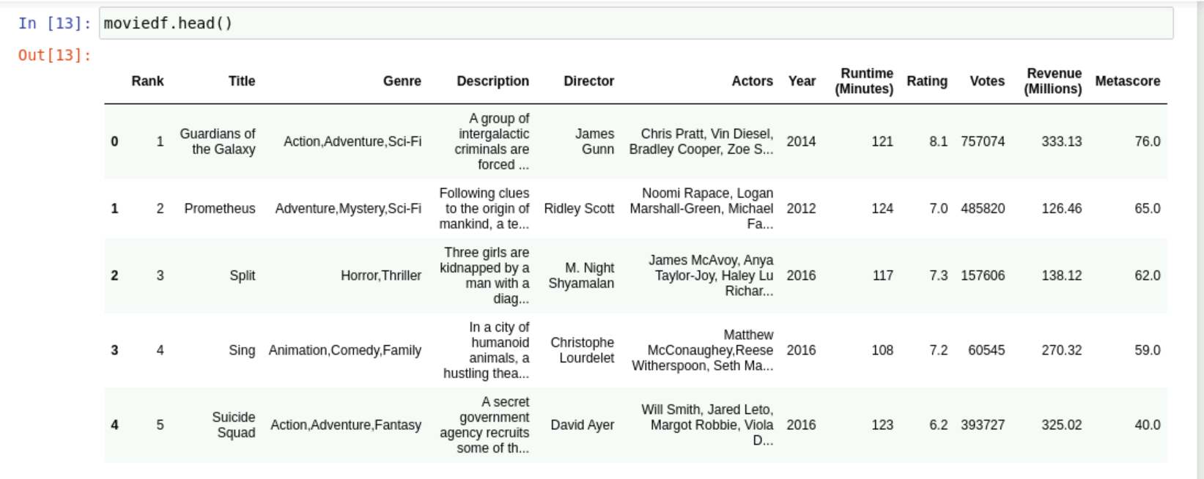
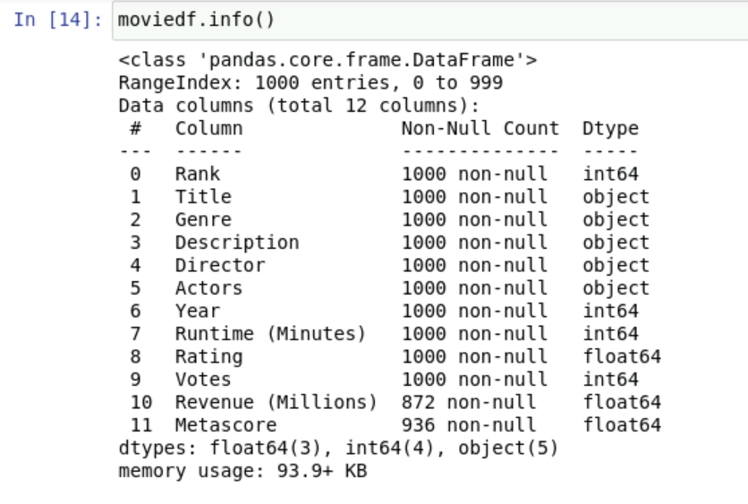
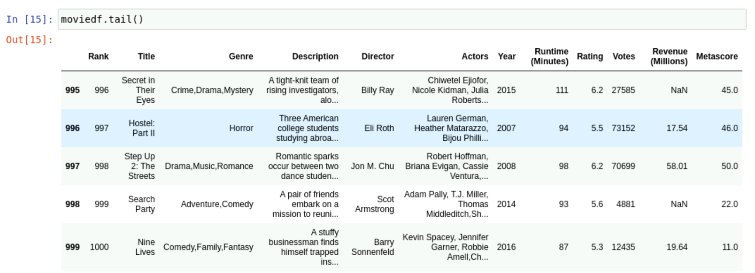
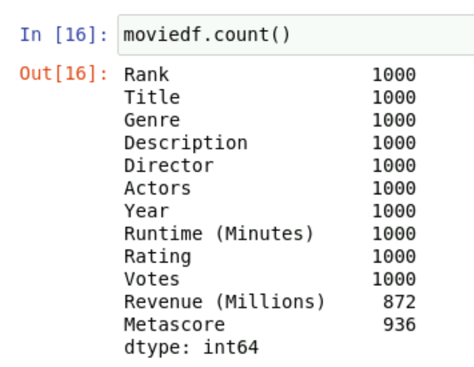

Slide 6
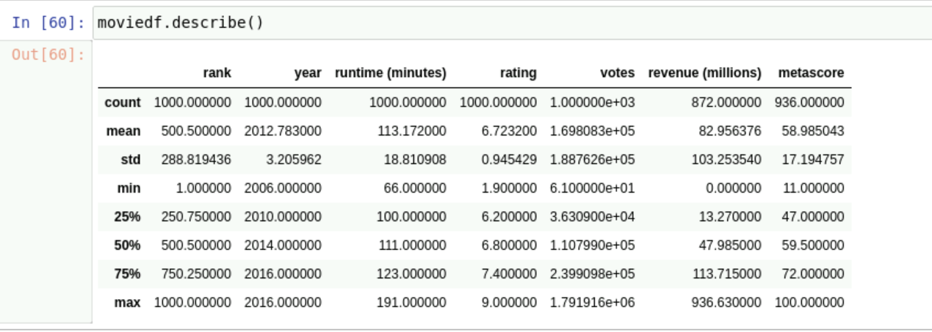
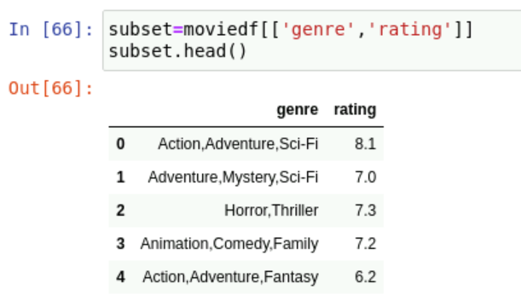
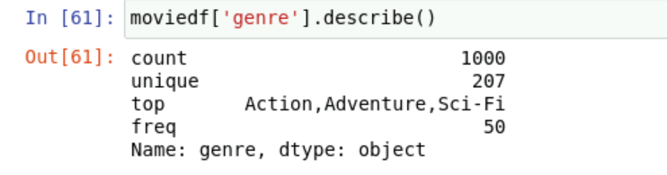
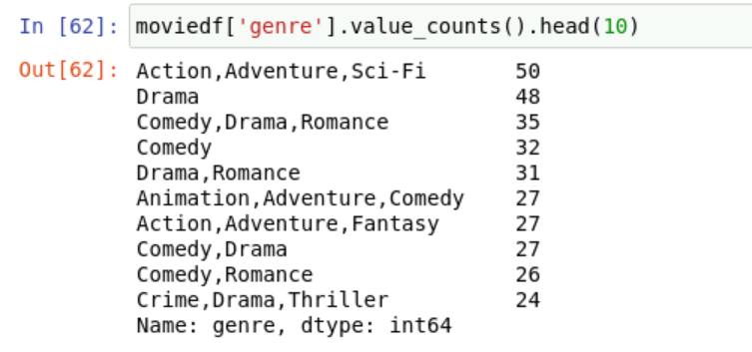
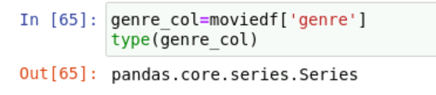
Explored more about: -
isnull()
Dropna()
Describe()
Value_counts()

Slide 7
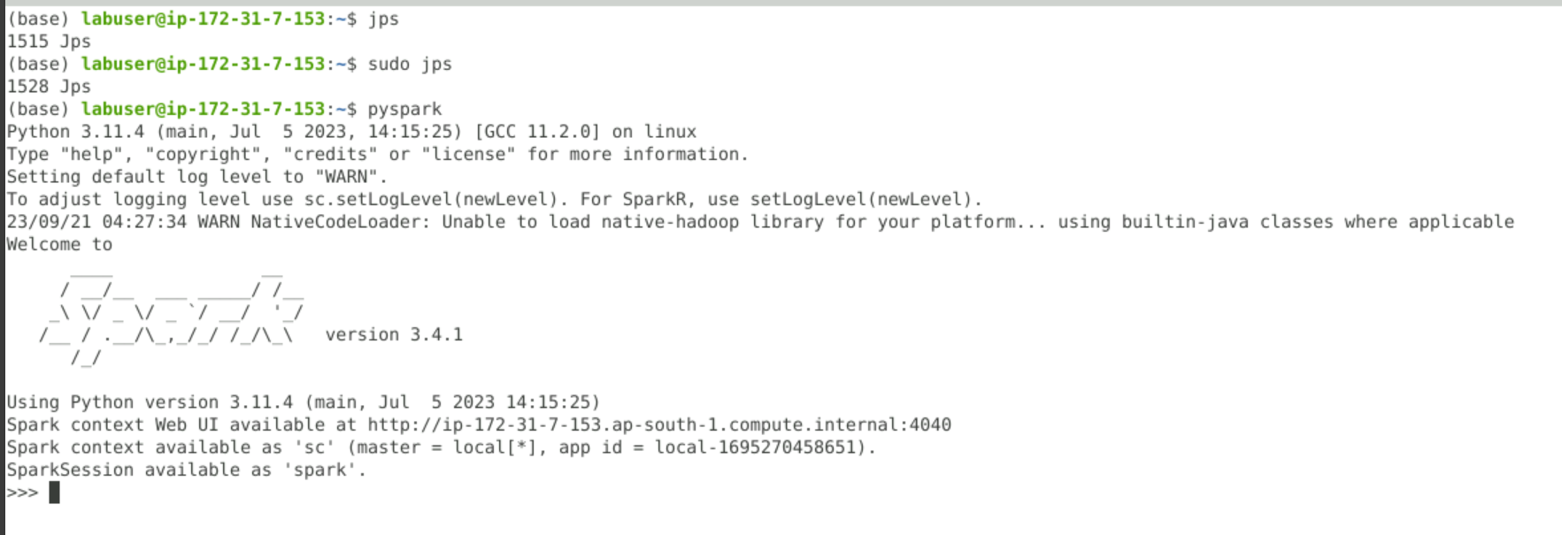
Day-4 Thursday(21st Sept)
-> Introduction to PySpark

Slide 8
-> Learnt about the building block of Spark, RDD
-> Learnt about the various features of RDD dataframe.
-> Learnt about various operations on spark.

Slide 9
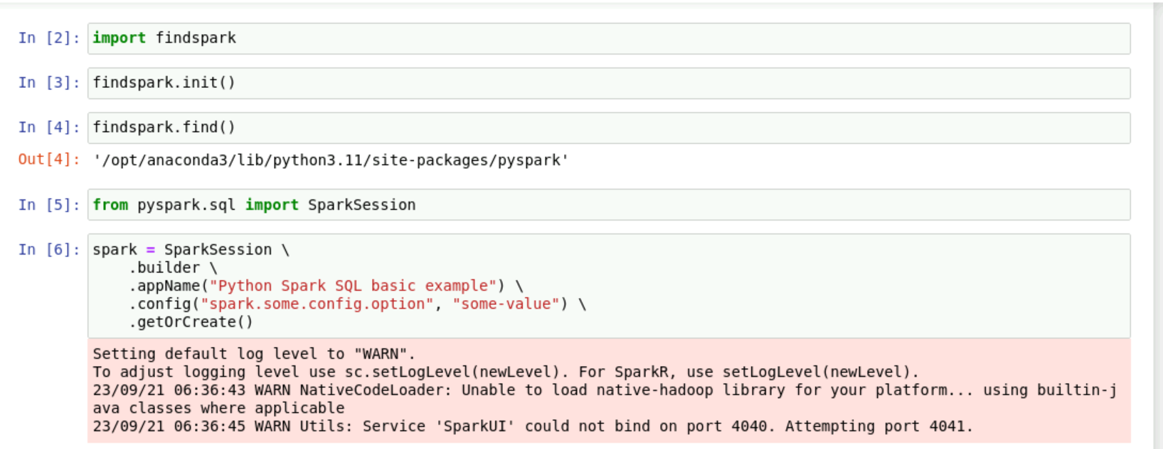
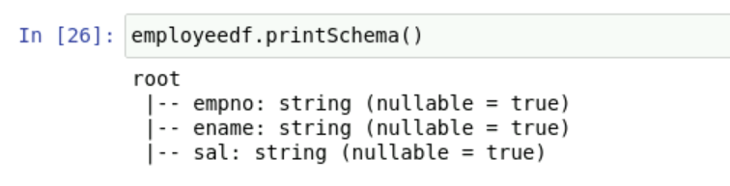
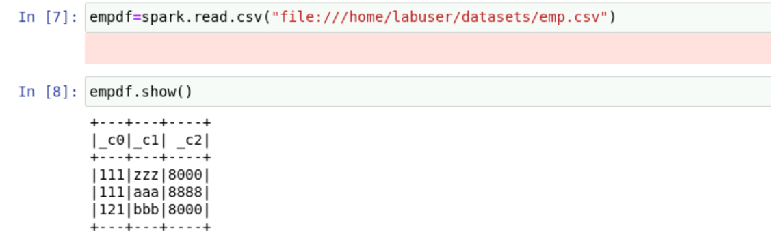
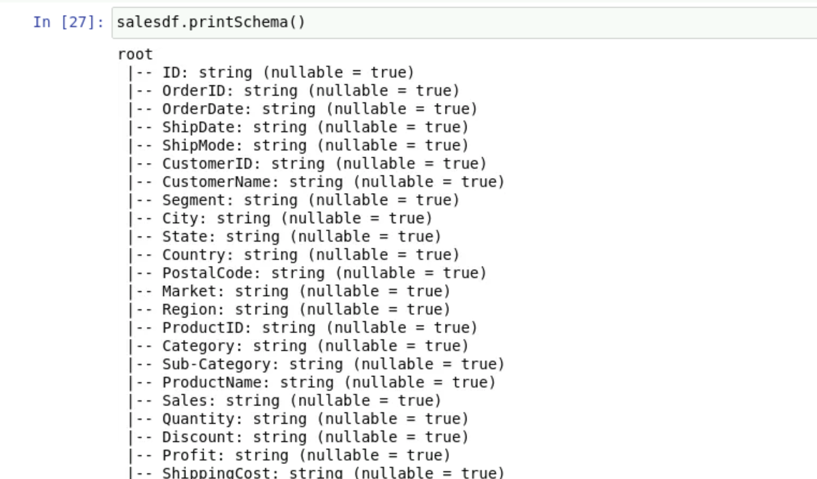
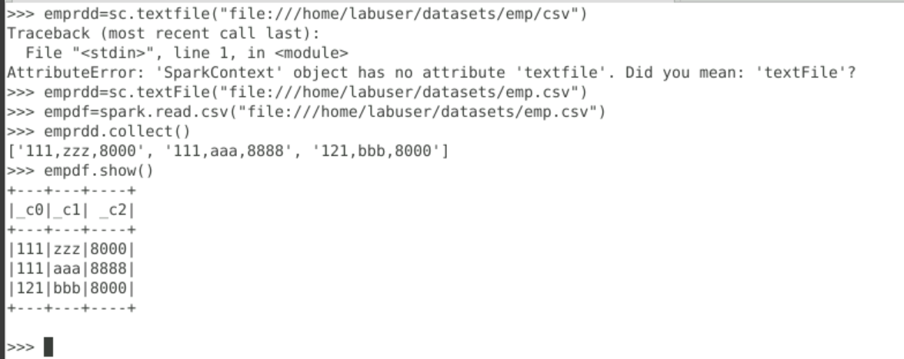

Slide 10
22nd Sept(Friday)
Learnt in details about how to remove bad records, duplicates and also about row filtering and column filtering.
Also learnt how to read a parquet file and how to persist and unpersist the storage level.

Slide 11
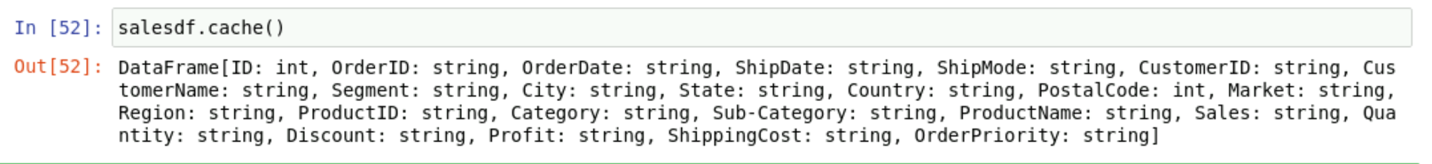
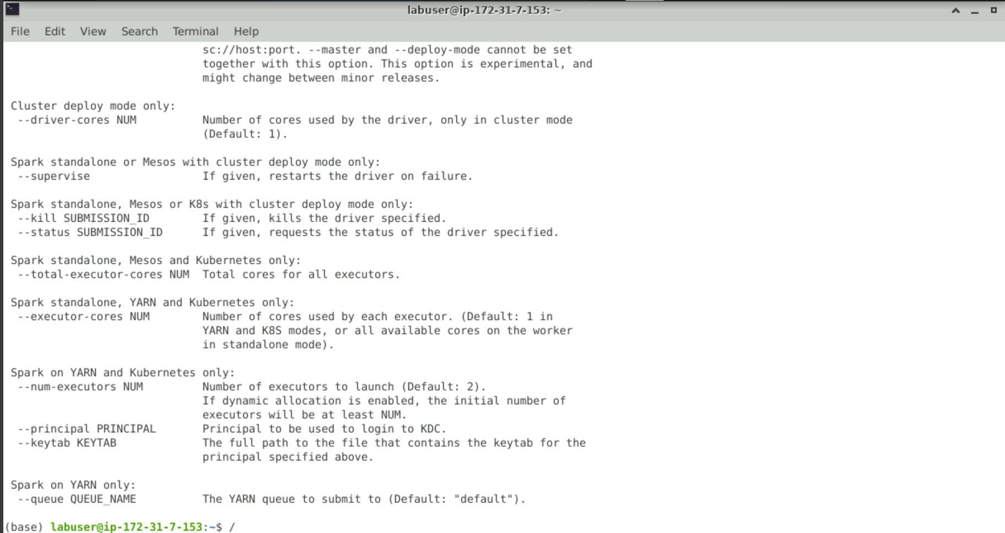

Slide 12
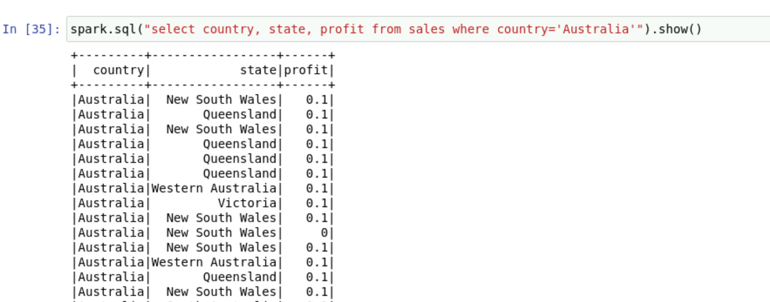
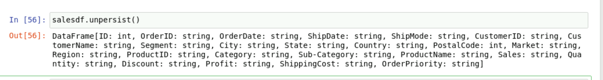
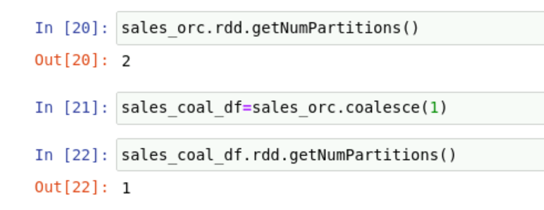
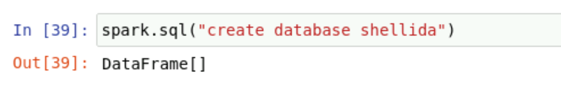

Slide 13
THANK YOU

